Slide 1
SHOGEKIJO
Only for those who watch anime.

Slide 2
What is SHOGEKIJO
SHOGEKIJO is a subscription-based streaming service that allows our members to watch anime on an internet-connected device.
This site can be used by the anime watchers to watch anime eliminating the need for pay tv channels and satellite broadcast .in addition , you can watch it on any device.

Slide 3
Basic Features of SHOGEKIJO
Multiple accounts and profiles
Home to all the fantastic anime movie' and films that SHOGEKIJO produce in-house.
Contains a huge catalogue of anime movie' and films that are produced by external companies.
Reasonably priced, no matter which package you decide to sign up to. Able to download some shows so you can watch offline.
Ultra HD facilities and the capability to watch content on four screens at the same time.

Slide 4
How we deliver business value?
Our primary motto is to understand the requirement of our client related to anime watching website.
Later we outperform our ways to offer them with technological solution while keeping your target audience and market in mind . Let’s get in touch to find out how we can help you in bringing

Slide 5
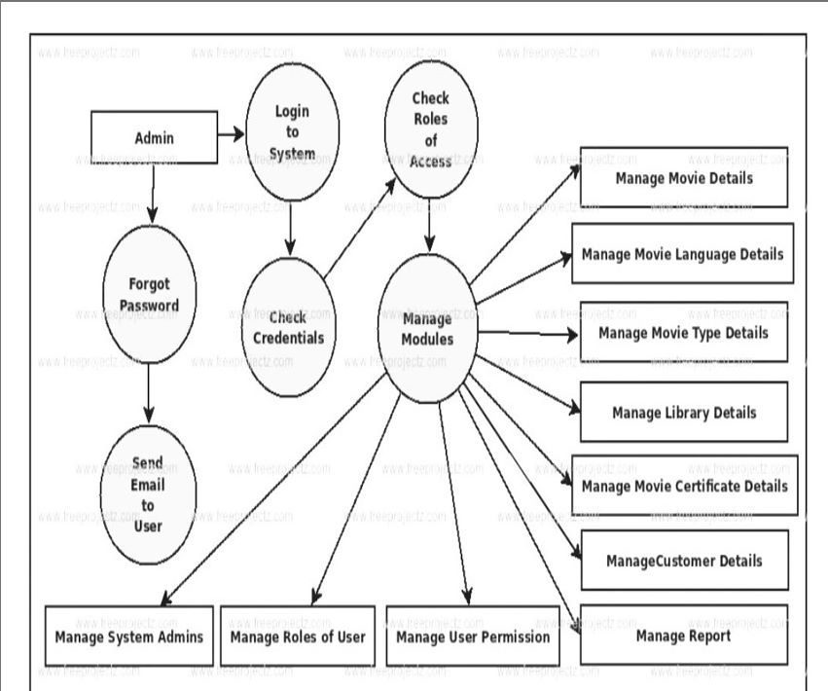
Dfd diagram

Slide 6
Tools and technology
HTML
CSS
PHP
JAVASCRIPT
MYSQL
XAMPP SERVER

Slide 7
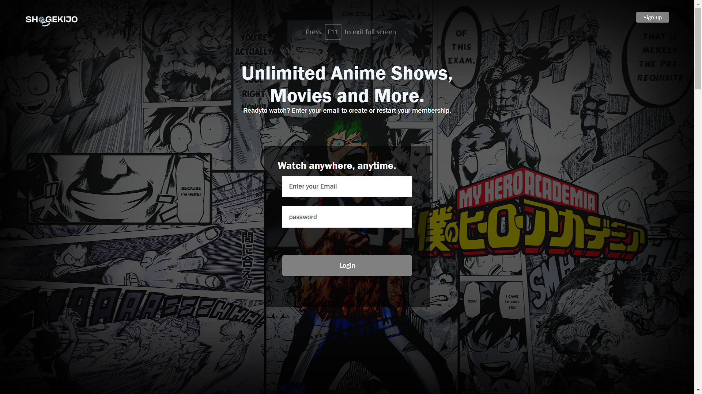
login PAGE

Slide 8
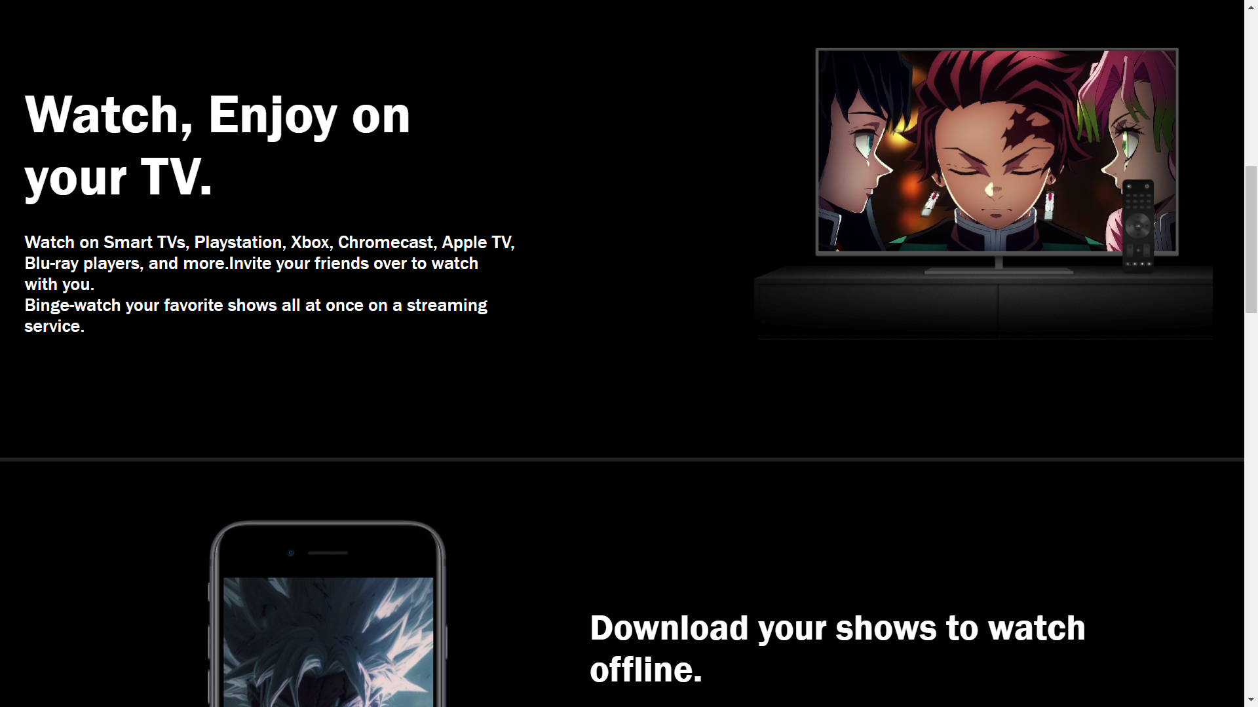
login PAGE

Slide 9
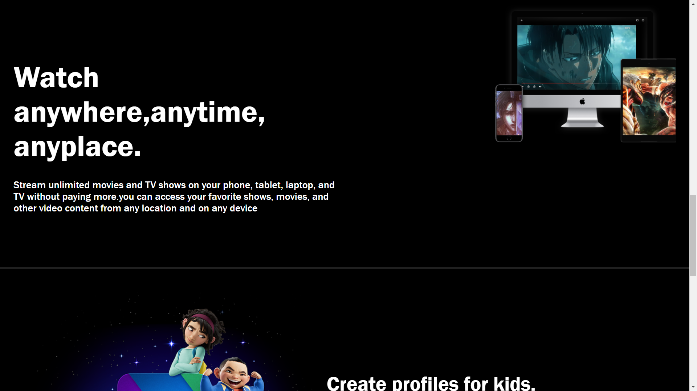
login PAGE

Slide 10
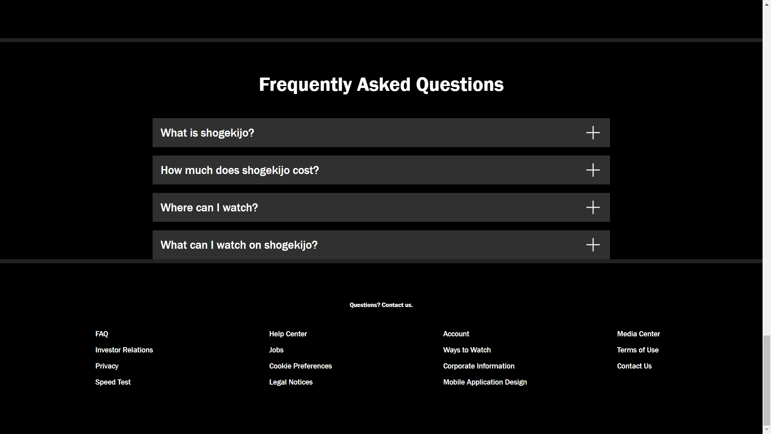
login PAGE

Slide 11
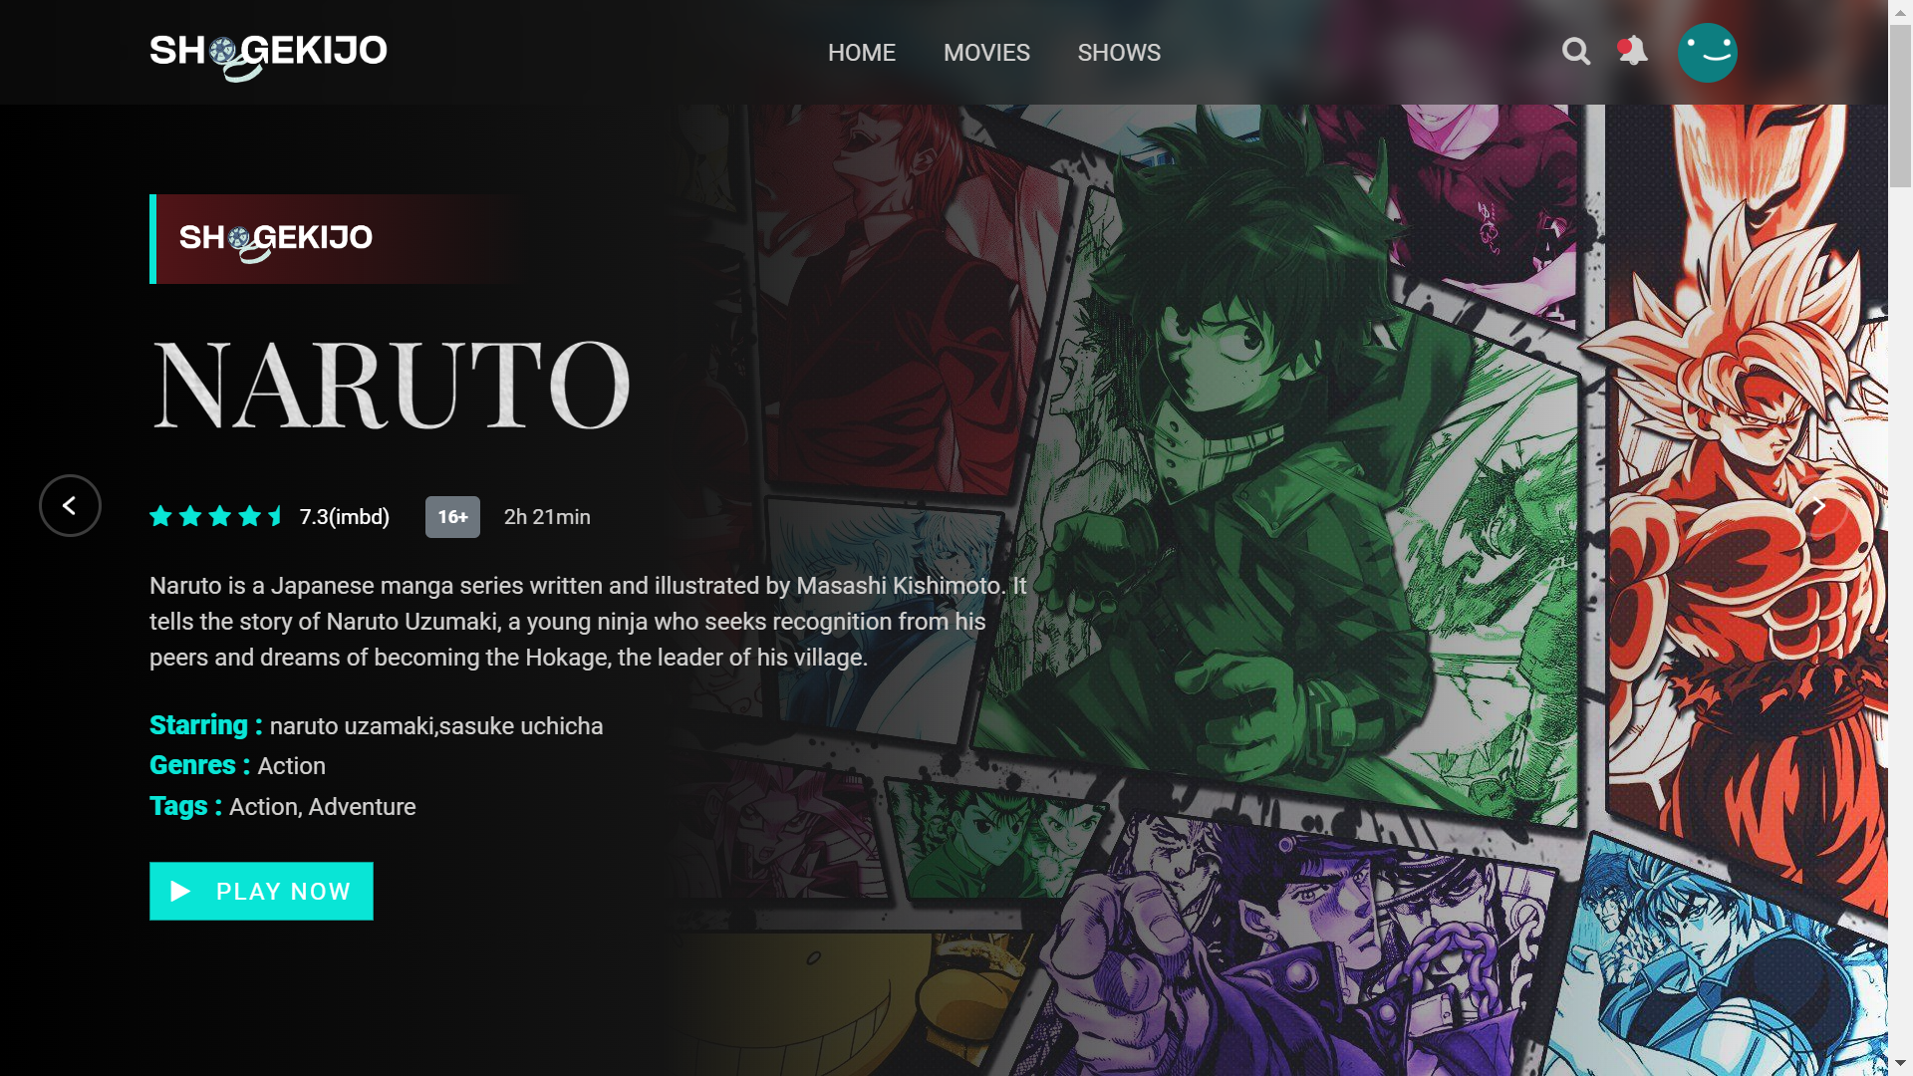
HOME PAGE

Slide 12
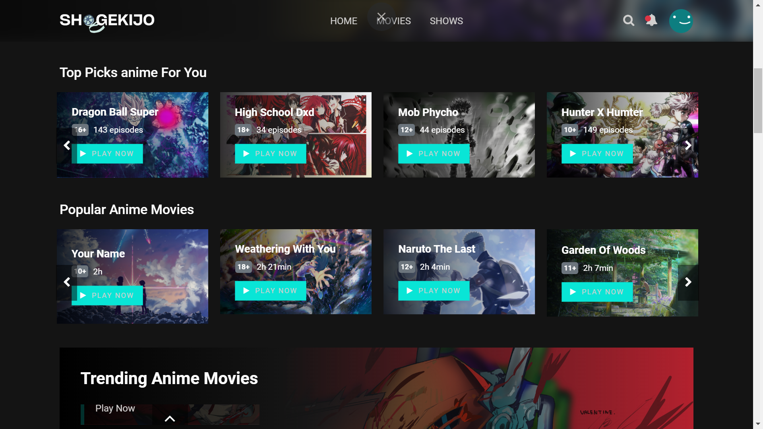
Popular anime

Slide 13
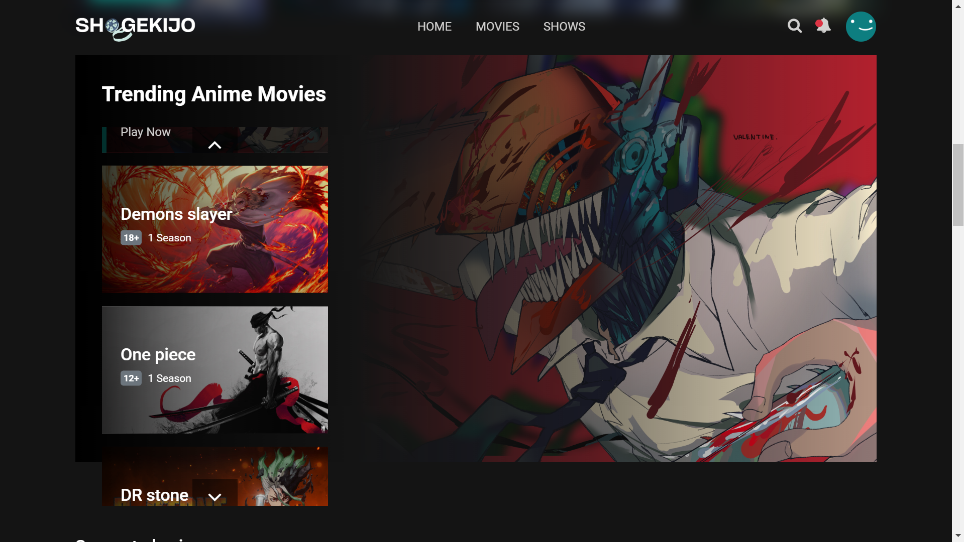
Trending anime

Slide 14
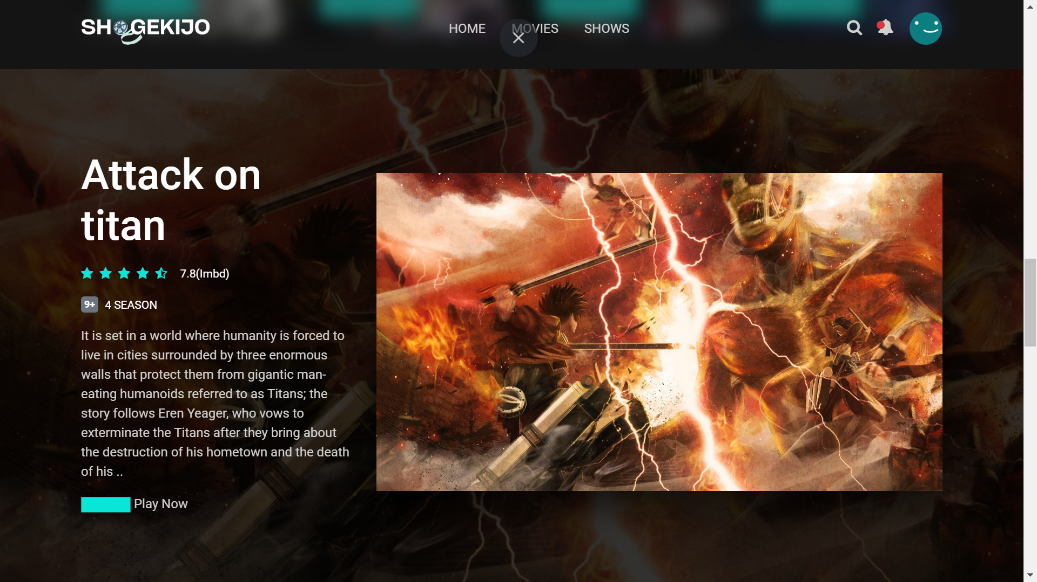
Trending anime

Slide 15

Trending shows

Slide 16
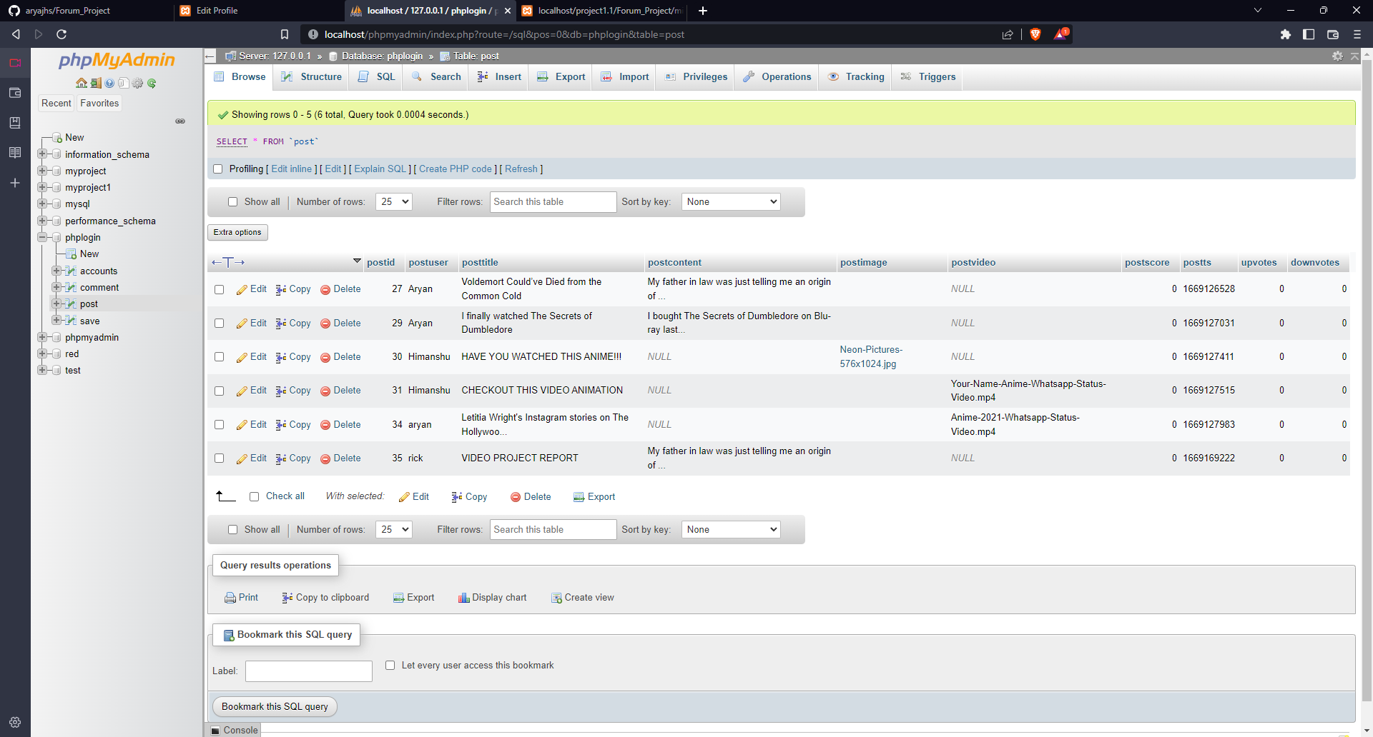
OUR DATABASE

Slide 17
SUMMARY
We chose "streaming service “ as our project because we wanted to gain experience in developing a Full-Stack website which gives us more insight into the Frontend its UI/UX and its Backend working of databases
The main objective of the project will be to provide user anime streaming site where he/she can have all anime in one go
Our Scope is to develop an appealing Frontend with easy to understand of user Interface and a comfortable user experience with working user input like login page, divided section, and user friendly interface so best anime can be watched without any problem

Slide 18
OUR TEAM MEMBERS
Saloni Shukla(201500611)
Aayush Garg(201500006)
Ashutosh Sahu(201500168)
Tanu Gola(201500740)

